Slide 1
Communications Technology & Social Change Activism
How can social change efforts take advantage of new media?
How can we build new technologies for activism and social change?
How can we take control of technology development as a means of social change?

Slide 2
1
How can social change efforts take advantage of new media technologies?

Slide 3
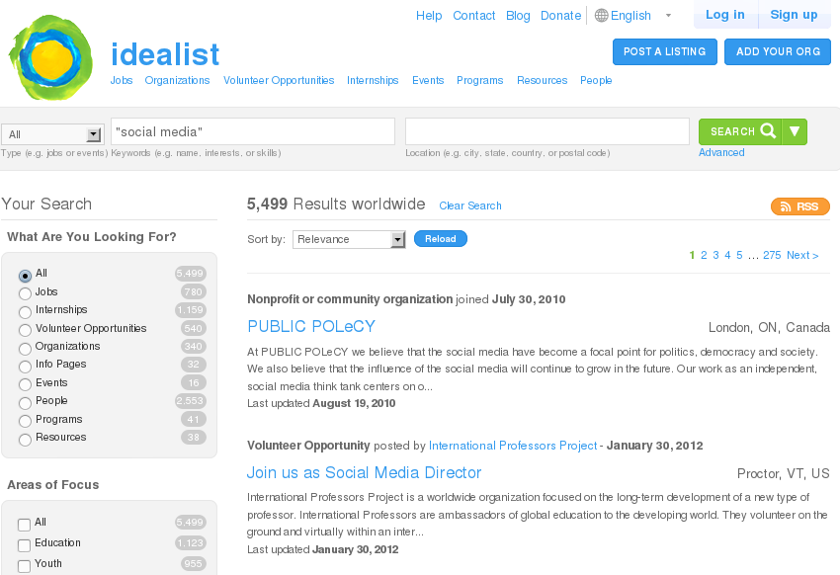

Slide 4
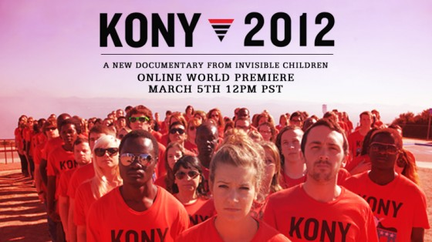

Slide 5
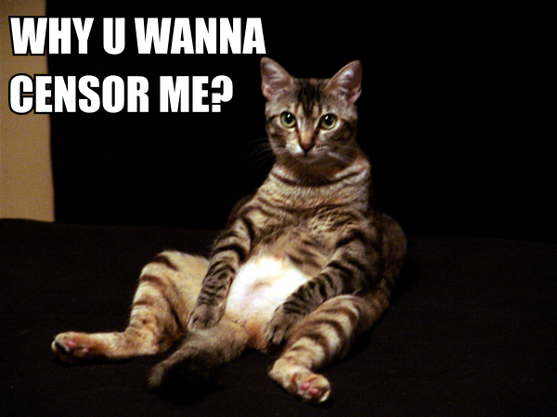
(Cute Cat Theory of Internet Censorship - Ethan Zuckerman)

Slide 6
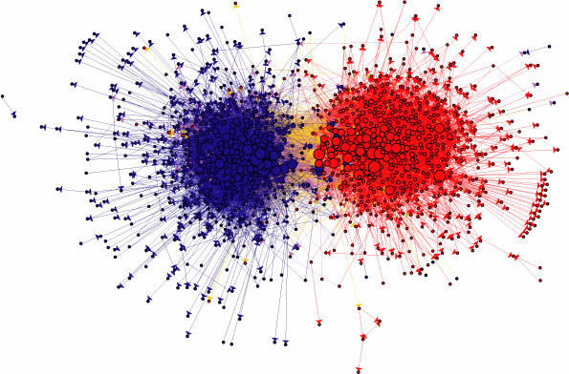
Polarization in Political Blogs
(Adamic and Glance 2005; Shaw and Benkler 2012)

Slide 7
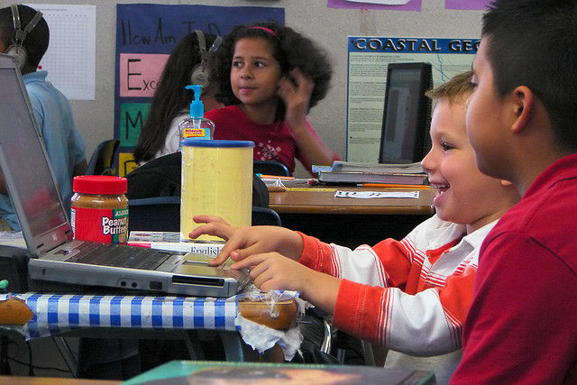
Reich et al. 2011 – Social Media In Classrooms

Slide 8
2
How can we build new technologies for activism and social change?

Slide 9
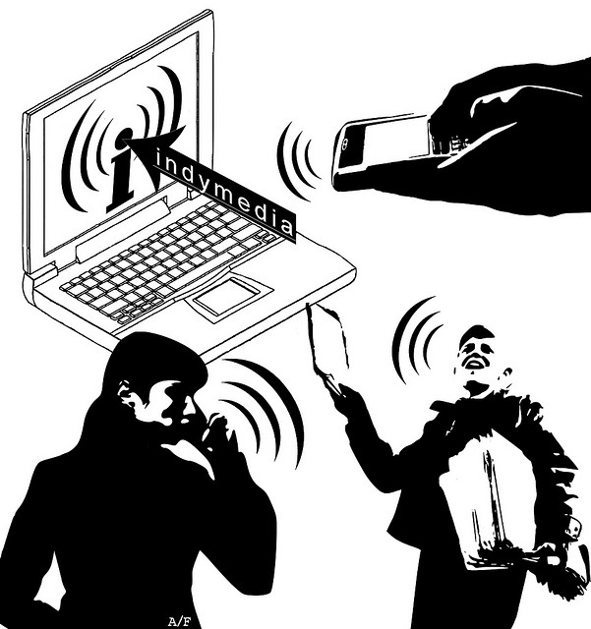

Slide 10
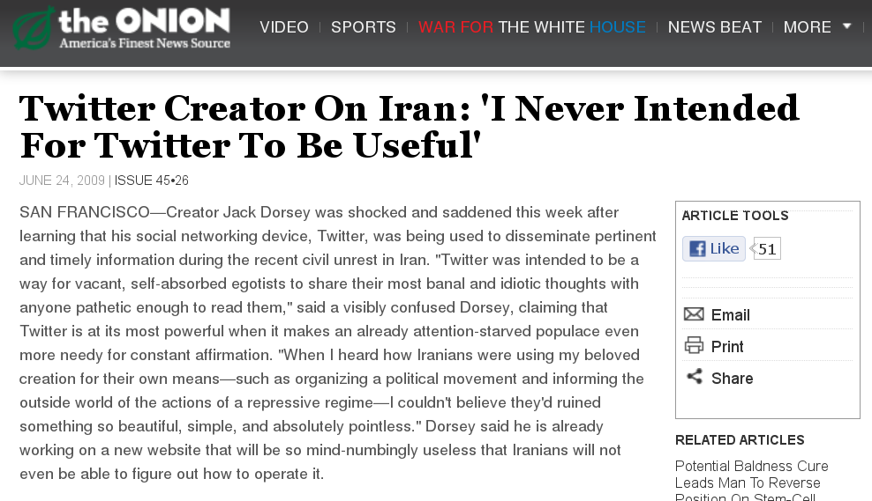

Slide 11
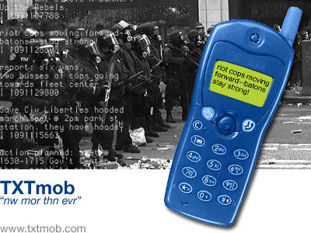

Slide 12
3
How can we take control of technology development as a means of social change?

Slide 13
Free Software's Freedoms
Use software for any purpose.
Study and modify.
Distribute copies to others.
Collaborate and share your changes.

Slide 14
$monitor = array( '42107457' => 1, '9359890' => 1);
// Put baddies (hotties?) in here
/* Monitoring these people's profile viewage.
Stored in central db on profile_views.
Helpful for law enforcement to monitor stalkers and stalkees. */
(Excerpts from Facebook accidental source code leak re-posted to blogs.)

Slide 15
